Slide 1
BlueChip Insurance 🏦
The leading provider of insurance solutions for Bluechip NFTs

Slide 2
🧠 Idea
Our mission: Peace of mind while owning and trading high-value NFTs
Comprehensive coverage for famous NFT collections ✨ CryptoPunks ✨ Bored Ape Yacht Club ✨ Art Blocks ✨ Pudgy Penguins ✨ Mutant Ape Yacht Club ✨ World of Women ✨ The Sandbox ✨ NBA Top Shot

Slide 3
❓ Why BlueChip Insurance
Bluechip NFTs are highly valuable and sought after
Protecting against loss, theft, and damage is crucial
Traditional insurance policies often exclude digital assets

Slide 4
🚀 Our Solution
Onchain insurance for Bluechip NFTs
Comprehensive coverage tailored to the unique risks of digital assets
Smart contracts ensure transparency, security, and efficiency

Slide 5
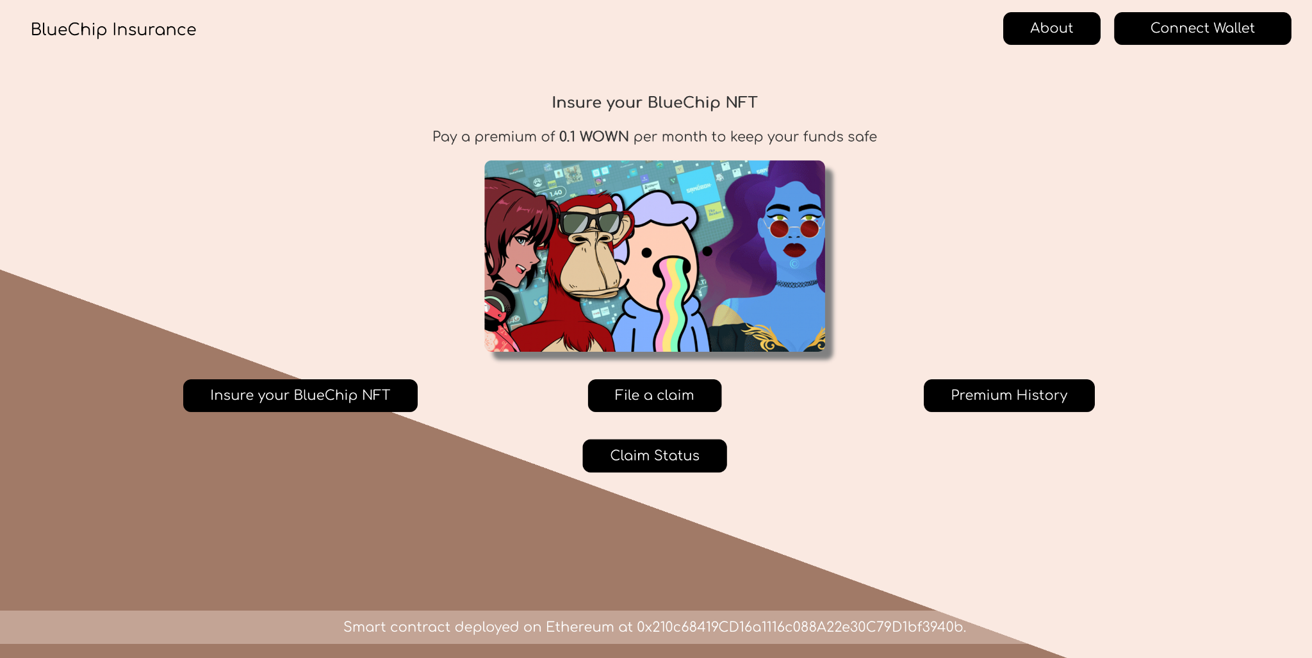
🚀 Our Solution
Be sure to see the video to see this in action!

Slide 6
🔑 Key Features
Coverage for a wide range of famous NFT collections
Protection against loss, theft, damage, and accidental destruction
100% on chain, built on Wowen blockchain

Slide 7
🌟 Benefits for Bluechip Collectors
Peace of mind: Safeguard your valuable investments
Enhanced value: Attract buyers with insured assets
Market confidence: Ensure trust and credibility in the NFT ecosystem

Slide 8
🗺️ Roadmap (1/2)
Phase 1: Launching BlueChip Insurance platform (DONE ✅)
Develop and deploy the BlueChip Insurance platform
Implement user registration and premium payment functionality
Phase 2: Expanding coverage to additional NFT collections
Research and evaluate popular NFT collections with high market demand
Customize coverage plans for each supported collection
Collaborate with collection creators and owners to ensure accurate valuation and risk assessment
Promote the availability of insurance coverage for these collections to attract new customers

Slide 9
🗺️ Roadmap (2/2)
Phase 3: Partnerships with leading NFT marketplaces
Identify and establish partnerships with major NFT marketplaces
Integrate BlueChip Insurance services directly into these platforms
Enable seamless insurance purchase and claim processes for users on partner marketplaces
Enhance visibility and accessibility of BlueChip Insurance by leveraging marketplace collaborations
Phase 4: Continuous improvement and innovation
Gather feedback from users and insurance policyholders
Enhance the platform's user experience and add new features based on user needs
Explore advancements in blockchain technology to further enhance security and transparency
Stay updated with evolving NFT trends and adapt insurance offerings accordingly

Slide 10
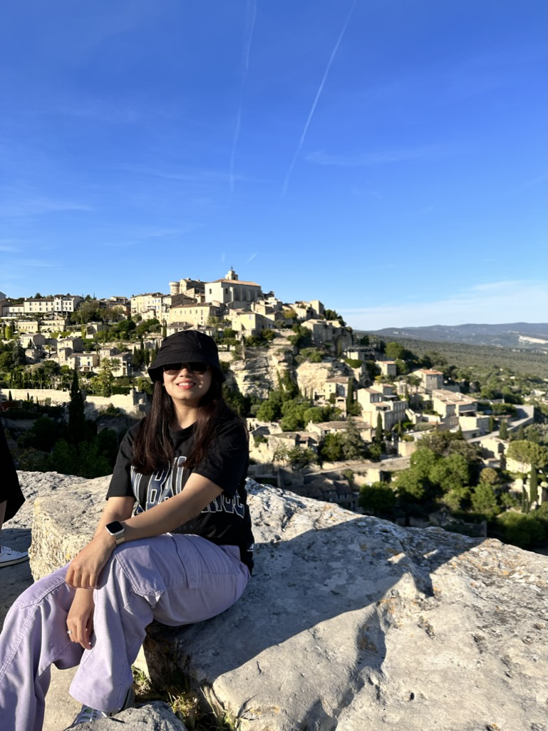
👋 Team
Hi, I am Niharika!
I am the team behind BlueChip Insurance.
I am a technical product manager @ daura ag
Email: hello@niharika.me
Twitter: @kiraonchain

